Slide 1


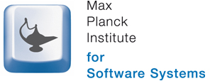




Inference and De-anonymization Attacks against Genomic Privacy
ETH Zürich
October 1, 2015
Mathias Humbert
Joint work with Erman Ayday, Jean-Pierre Hubaux, Kévin Huguenin, Joachim Hugonot, Amalio Telenti

Slide 2
(Human) System Security
How is a human system encoded?
Programmer 1
Programmer 2
A | T | G | G | C | C | G | A | C
0 | 1 | 0 | 0 | 1 | 1 | 0 | 0 | 1
0 | 0 | 1 | 0 | 1 | 1 | 0 | 1 | 1
A | A | T | G | C | C | A | T | C
0 | 0 | 1 | 0 | 1 | 1 | 0 | 1 | 1
0 | 1 | 1 | 0 | 2 | 2 | 0 | 1 | 2
0 | 1 | 0 | 0 | 1 | 1 | 0 | 0 | 1
The human genome can be represented as a sequence of ternary values (called SNP/SNV)
Computer -> human systems:
Binary -> ternary values!

Slide 3


Programming Human Beings…
Programmer 1: Father
Programmer 2: Mother
. . .
A | T | T | G | C | C | G | A | C
. . .
. . .
A | A | T | G | T | C | G | T | C
. . .
C | T | G | G | T | C | A | A | T
C | T | T | G | C | C | A | A | C
Gamete
Production
Gamete
Production
A | T | G | G | C | C | G | A | C
A | A | T | G | C | C | A | T | C
A | A | T | G | C | C | A | T | C
0 | 1 | 1 | 0 | 2 | 2 | 0 | 1 | 2
A | T | G | G | C | C | A | A | C
Child

Slide 4

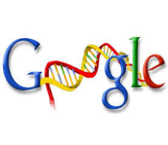





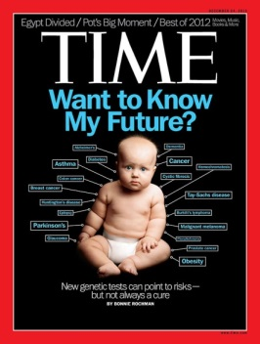
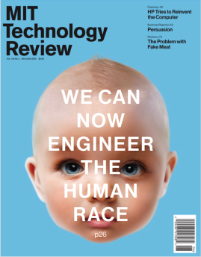

Genomic Data Deluge
Genotyping < 100$ today
> 950k people genotyped by 23andMe
Recent governmental and industrial initiatives
President Obama’s Precision Medicine Initiative (01/2015) => 1M+ citizens
Google Genomics (API to store, process, explore, and share DNA data)
Microsoft Research (genomic research in collaboration with Sanger Center)
Global Alliance for Genomics & Health (common framework for effective, responsible and secure sharing of genomic and clinical data)
Genomic-data benefits
Providing substantial improvement in diagnosis and personalized medicine
Helping medical research progress
Sharing of genomic data
Thousands of genomes are already available online (OpenSNP, Personal Genome Project, …)
First motivation for sharing: help research [1]
[1] http://opensnp.wordpress.com/2011/11/17/first-results-of-the-survey-on-sharing-genetic-information/

Slide 5
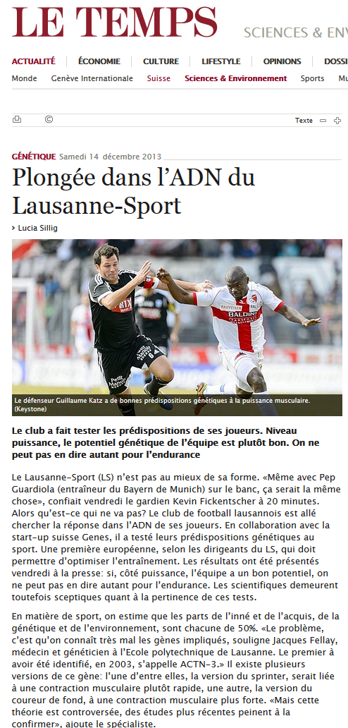

Genomic Privacy Risks
Genome carries sensitive information about
Predisposition to diseases
Genetic discrimination in health or life insurance, …
Future physical conditions
Genetic discrimination in work, sports, ...
Kinship
Familial tragedies (like divorce caused by the discovery of illegitimate offspring [2])
Physical appearance, metabolism
The privacy situation is worsened by
The non-revokability of genomic data
Interdependent risks
[2] http://www.vox.com/2014/9/9/5975653/with-genetic-testing-i-gave-my-parents-the-gift-of-divorce-23andme

Slide 6
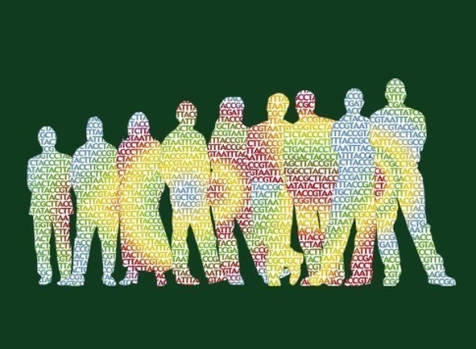

Outline
Statistical inference
Kin genomic privacy
M. Humbert, E. Ayday, J.-P. Hubaux, A.Telenti. Addressing the Concerns of the Lacks Family: Quantification of Kin Genomic Privacy. CCS 2013
De-anonymization
Of genomic databases with phenotypic traits
M. Humbert, K. Huguenin, J. Hugonot, E. Ayday, J.-P. Hubaux. De-anonymizing Genomic Databases with Phenotypic Traits. PETS 2015
?
?
?
?
?

Slide 7
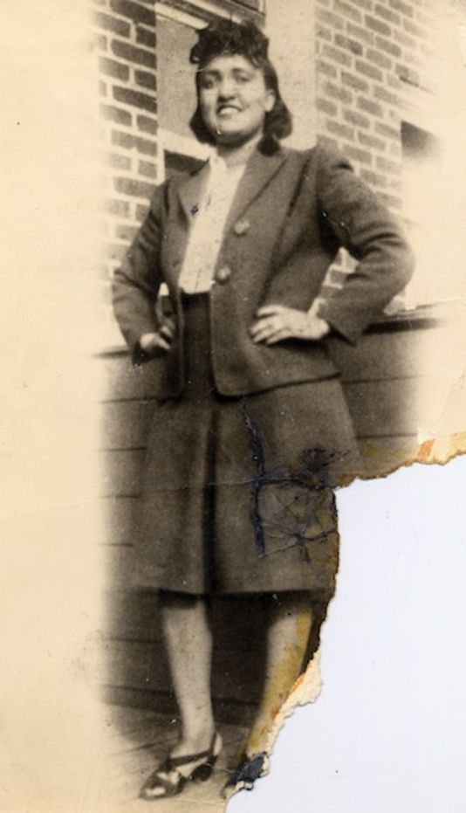
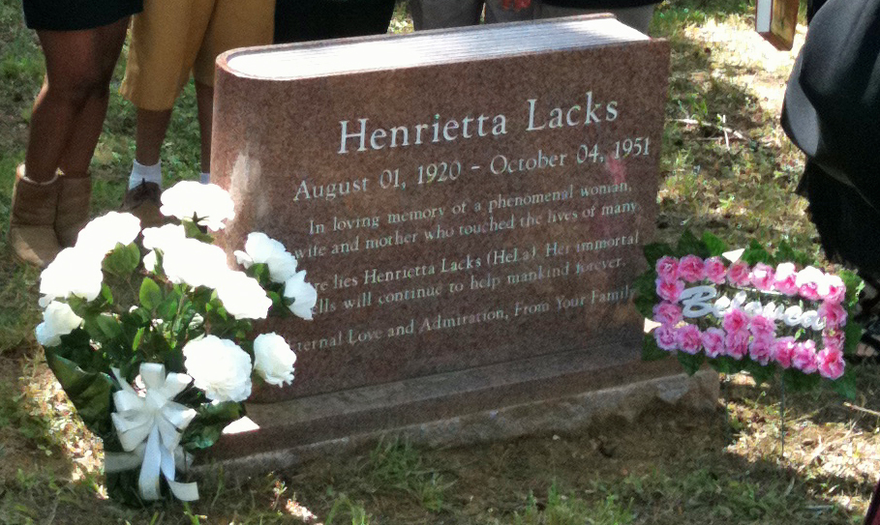
Henrietta Lacks and her Family

Slide 8
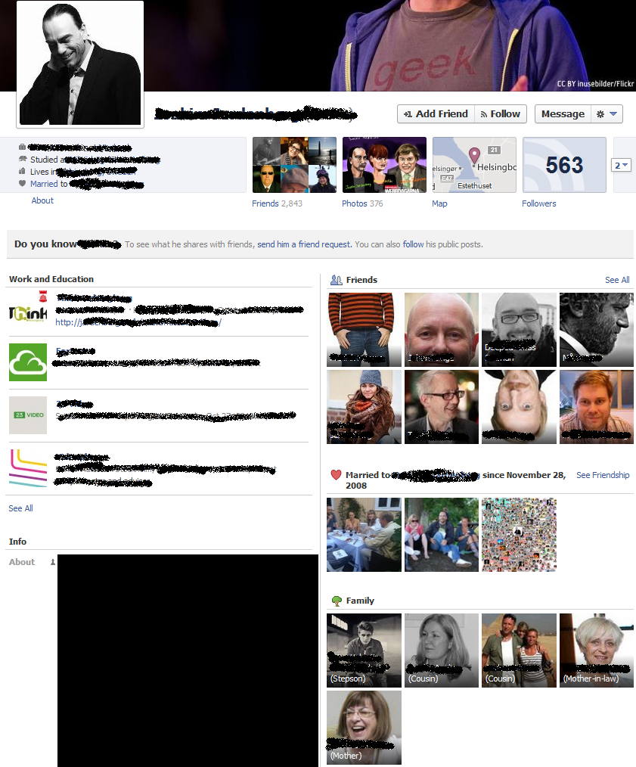
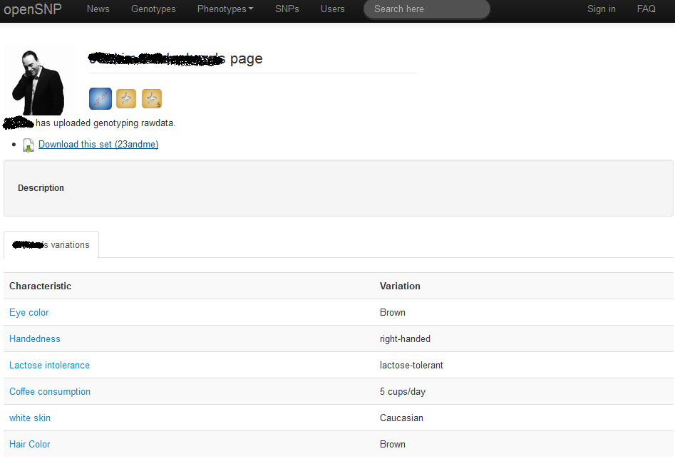
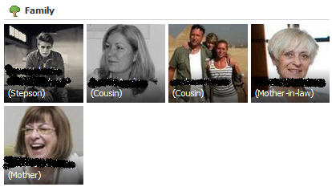
Cross-Website Attack
Correlated genetic information between family members => an individual sharing his/her genome threatens his (known) relatives’ genomic privacy

Slide 9
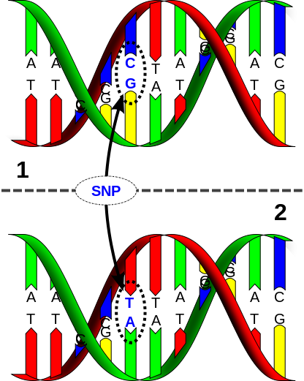
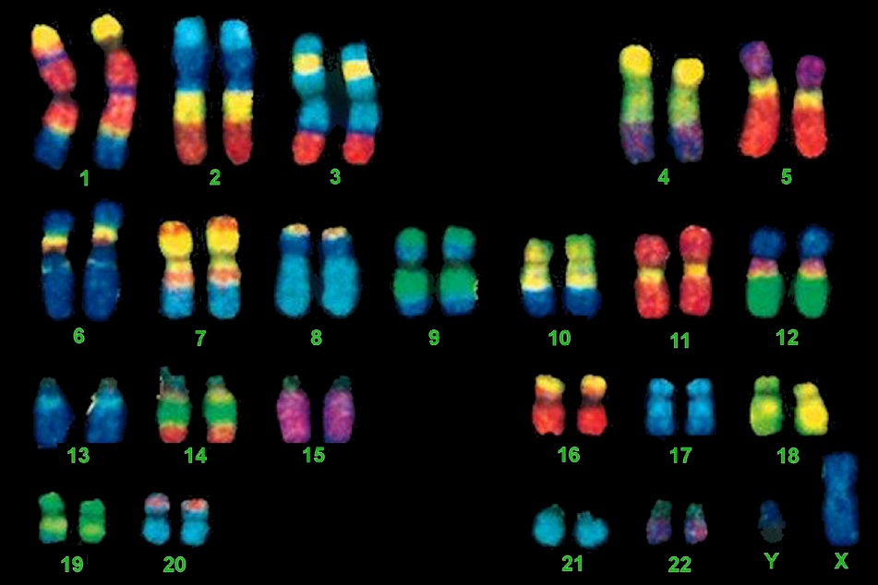
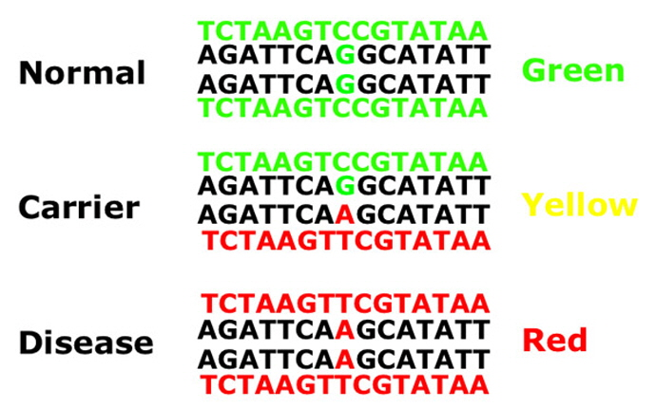
Genomics 101
Human genome consists of 3 billion nucleotide pairs, i.e. 3B pairs of 4 letters (A, C, G, or T)
Organized into 23 pairs of chromosomes
~99.9% of the genome is identical between 2 individuals
Single nucleotide polymorphism (SNP)
> 50 million SNP positions in human genome
Disease risk can be computed by analyzing particular SNPs
Notes:
SNP is the most commonly studied variant

Slide 10
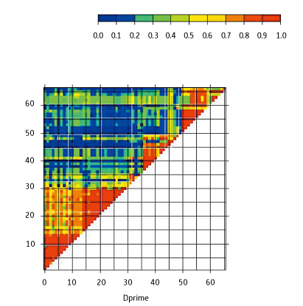
Linkage Disequilibrium (LD)
Linkage disequilibrium: Correlation between pairs of SNPs
D = Pr(X=A, Y=B) – Pr(X=A)Pr(Y=B)
D’ = normalized D
From these LD metrics, we can compute pairwise joint probabilities between any SNPs
D’
Observed frequencies
Expected frequencies under independence
SNP ID
SNP ID
Notes:
SNP closer in a physical manner

Slide 11
Quantifying Kin Genomic Privacy
Quantifying privacy risks
With respect to the amount of genomic data that is revealed, and the relative(s) revealing it
Considering the background knowledge of the adversary (familial relationships, LD values, minor allele frequencies)
Designing efficient inference algorithms that mimic reconstruction attacks given background knowledge
In order to propose protection mechanisms to reduce the inherent genomic-privacy risk

Slide 12
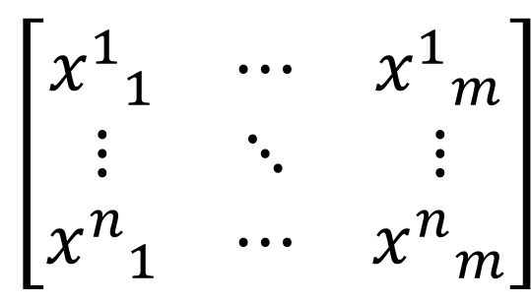
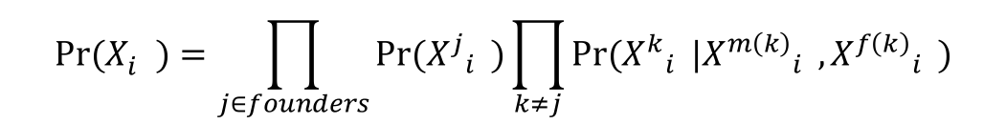
Reconstruction Attacks
Adversary’s objective:
Compute the posterior marginal probabilities of the family’s SNPs given:
The observed data (publicly available SNPs)
The background knowledge (inheritance probabilities, population allele frequencies, LD statistics)
SNP positions
$$\left[\begin{matrix}{x^{1}}_{1}^{} & ⋯ & {x^{1}}_{m}^{} \\ ⋮ & ⋱ & ⋮ \\ {x^{n}}_{1}^{} & ⋯ & {x^{n}}_{m}^{}\end{matrix}\right]$$
Given by a sparse pairwise joint probability matrix L where L_{i,j} = Pr(X_{i},X_{j})
relatives
$$Pr⁡(X_{i}^{})=\prod_{j∈founders}{Pr⁡({X^{j}}_{i}^{})}\prod_{k≠j}{Pr⁡({X^{k}}_{i}^{}|{X^{m\left(k\right)}}_{i}^{},{X^{f\left(k\right)}}_{i}^{})}$$

Slide 13
Inference Algorithms
Naive marginalization of any of the random variable has computational complexity O(3^{mn} )
We chose to run belief propagation (a.k.a message passing) on graphical models to reduce the computational complexity
Exact inference without considering LD between SNPs
Junction tree algorithm = belief propagation on a junction tree
Complexity = O(mn)
Approximate inference if LD included
Loopy belief propagation on a factor graph
Complexity = O(mn) per iteration

Slide 14
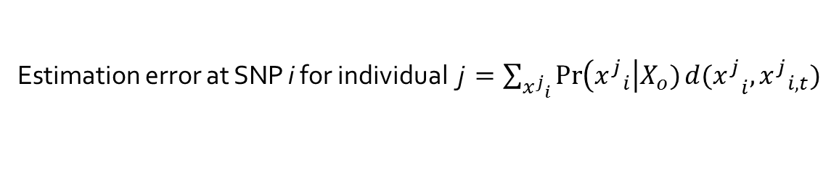
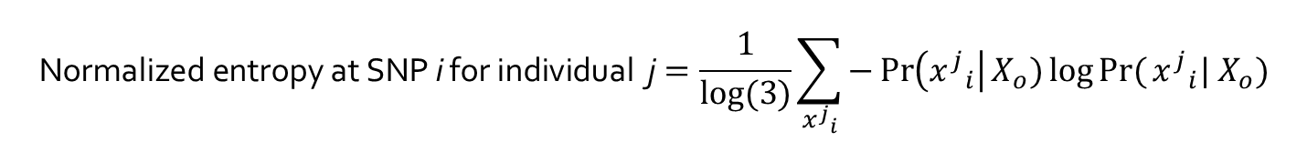



Privacy Metrics
${x^{j}}_{i}^{}$ $∈\{0,1,2\}$ : inferred value
${x^{j}}_{i,t}^{}$ $∈\{0,1,2\}$ : actual value
$X_{o}$ : observed SNPs
Adversary’s incorrectness [3]
Adversary’s uncertainty [4]
Mutual information-based metric [5]
Estimation error at SNP i for individual j $=\sum_{{x^{j}}_{i}^{}}{\operatorname{Pr}\left({x^{j}}_{i}^{}\right|X_{o})d{(x^{j}}_{i}^{},{x^{j}}_{i,t}^{})}$
$$\text{N}\text{ormalized} \text{entropy} \text{at} \text{SNP} \text{i} \text{for} \text{individual} \text{j}=\frac{1}{log⁡(3)}\sum_{{x^{j}}_{i}^{}}{−\operatorname{Pr}\left({x^{j}}_{i}^{}\right|X_{o})\log{Pr⁡(}{x^{j}}_{i}^{}| X_{o})}$$
1 – (normalized) mutual information at SNP i for individual j$=1−\frac{H\left({x^{j}}_{i}^{}\right)−H\left({x^{j}}_{i}^{}\right|X_{o})}{H\left({x^{j}}_{i}^{}\right)}=\frac{H\left({x^{j}}_{i}^{}\right|X_{o})}{H\left({x^{j}}_{i}^{}\right)}$
[3] R. Shokri et al., Quantifying location privacy, S&P 2011
[4] A. Serjantov, G. Danezis, Towards an information theoretic metric for anonymity, PET 2003
[5] D. Agrawal, C.C. Aggarwal, On the design and quantification of privacy preserving data mining algorithms, PODS 2001

Slide 15
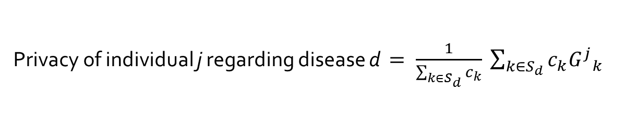



Genomic and Health Privacy
Genomic-Privacy Metrics
Individual genomic privacy = average value over all of his SNPs
Using any of the previously defined privacy metrics
Whole family genomic privacy = average over all SNPs
Using any of the previously defined privacy metrics
Health-Privacy Metrics
Privacy of individual j regarding disease d $= \frac{1}{\sum_{k∈S_{d}}{c_{k}}} \sum_{k∈S_{d}}{c_{k}{G^{j}}_{k}^{}}$
$S_{d}$: set of SNPs associated with disease d
${G^{j}}_{k}^{ }$: genomic privacy of individual j at SNP k
$c_{k}$: contribution of SNP k to disease d

Slide 16
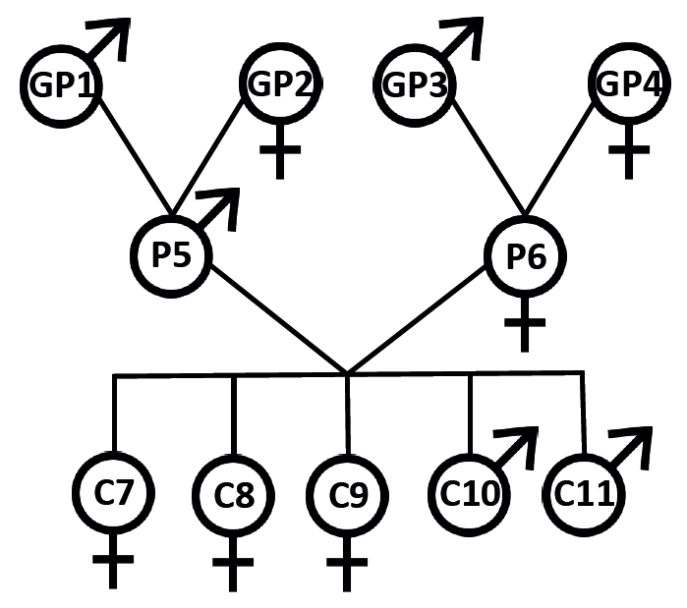
Framework Evaluation
Pedigree from Utah
Family containing 4 grandparents, 2 parents, and 5 children
Focusing on chromosome 1 (longest one)
Relying on the three privacy metrics to quantify genomic privacy and health privacy
Using the L1 distance to measure the distance between two SNPs in the estimation error metric

Slide 17
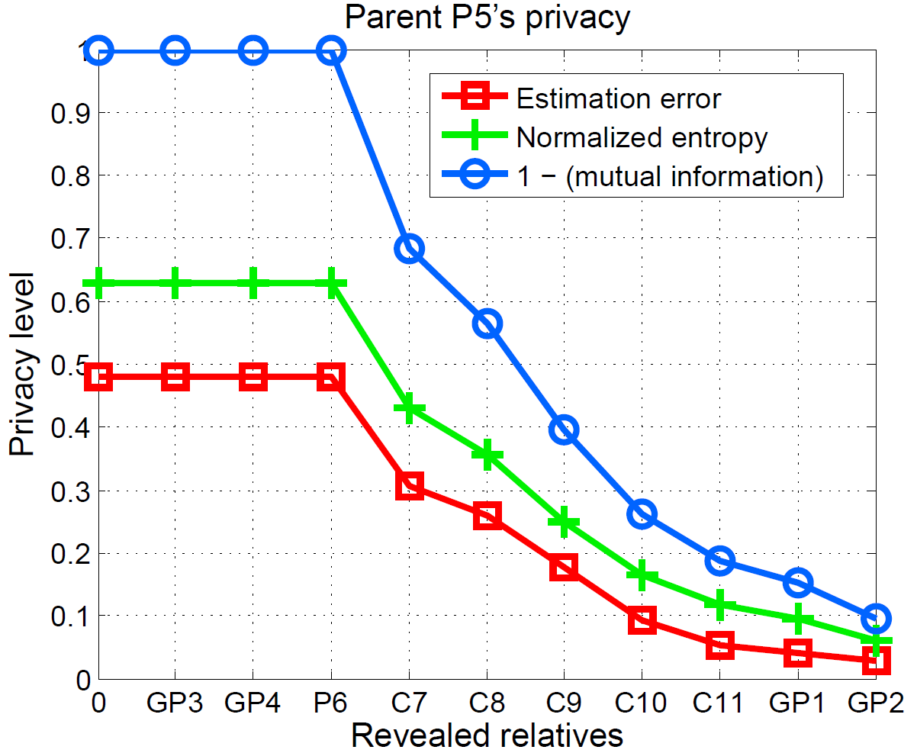
80k SNPs, without LD
Evolution of the genomic privacy of parent P5 by gradually revealing the SNPs of other family members (starting with the most distant family members)

Slide 18
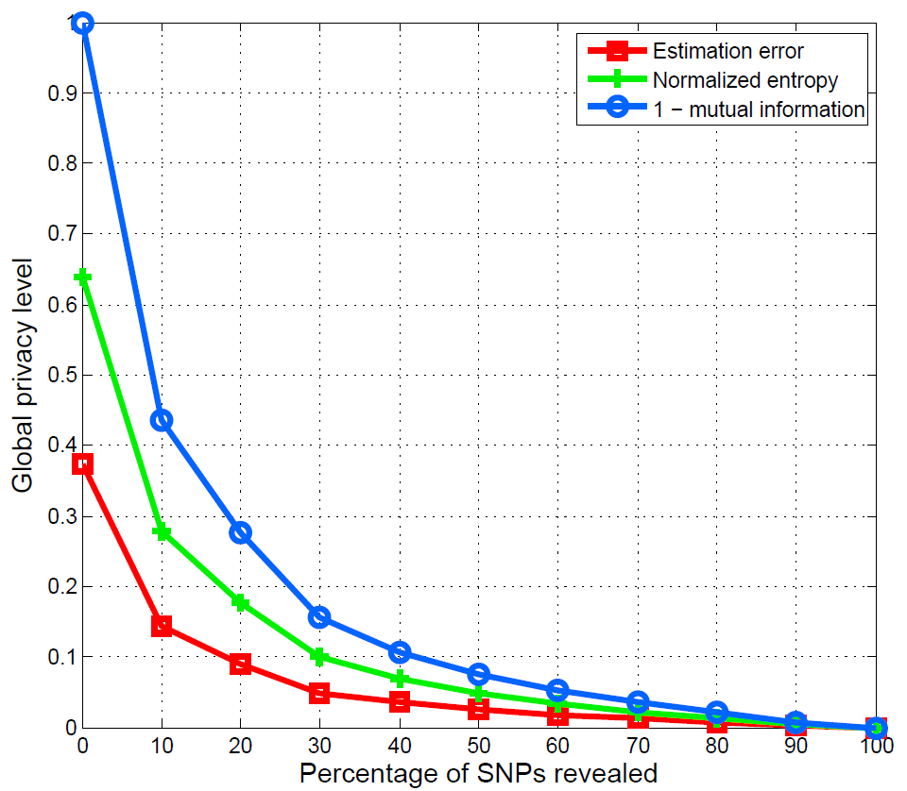
100 SNPs in the same region, with LD
Evolution of the global genomic privacy for the whole family by gradually revealing 10% of the SNPs (that are randomly selected at each step)

Slide 19
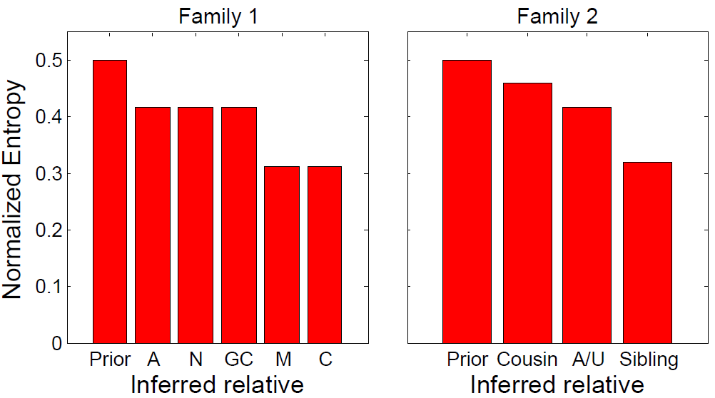
Real Attack Example
Linking OpenSNP and Facebook with user names
6 individuals sharing their SNPs on OpenSNP found on Facebook, who also publicly reveal (some of) their relatives
29 individuals in 6 different families
With one member revealing his/her SNP in each family
Health-privacy evaluation for two families
Focusing on SNPs relevant for Alzheimer’s disease
2 SNPs that are equally contributing to the disease predisposition
1 person/family revealing these 2 SNPs

Slide 20
Summary
Framework to quantify kin genomic privacy given actual observation and background knowledge
Trade-off between time efficiency and attack power
If the attacker is interested only in a subset of targeted SNPs or if he cannot observe the full set of SNPs of a relative, he would make use of the inference method that includes LD
From the decision/policy maker’s point of view, the inference method without LD gives an upperbound on the actual level of genomic privacy of the family members
Optimized protection mechanism
Obfuscation mechanism and combinatorial optimization

Slide 21
Outline
Statistical inference
Kin genomic privacy
M. Humbert, E. Ayday, J.-P. Hubaux, A.Telenti. Addressing the Concerns of the Lacks Family: Quantification of Kin Genomic Privacy. CCS 2013
De-anonymization
Of genomic databases with phenotypic traits
M. Humbert, K. Huguenin, J. Hugonot, E. Ayday, J.-P. Hubaux. De-anonymizing Genomic Databases with Phenotypic Traits. PETS 2015
?
?
?
?
?

Slide 22
Genome Sharing and Anonymity
Sharing genomic data with privacy
Naive solution: anonymizing genomic data
Anonymity of genomic data broken with two types of auxiliary information
Census data (ZIP code, birth date, …) [6]
Y-chromosome short tandem repeats (STRs) [7]
Currently not included in the genotypes provided by most popular direct-to-consumer genetic testing providers (such as 23andMe)
Other means to de-anonymize genomic data?
[6] L. Sweeney et al., Identifying Participants in the Personal Genome Project by Names, Report, 2013
[7] M. Gymrek et al., Identifying Personal Genomes by Surname Inference, Science, 2013

Slide 23
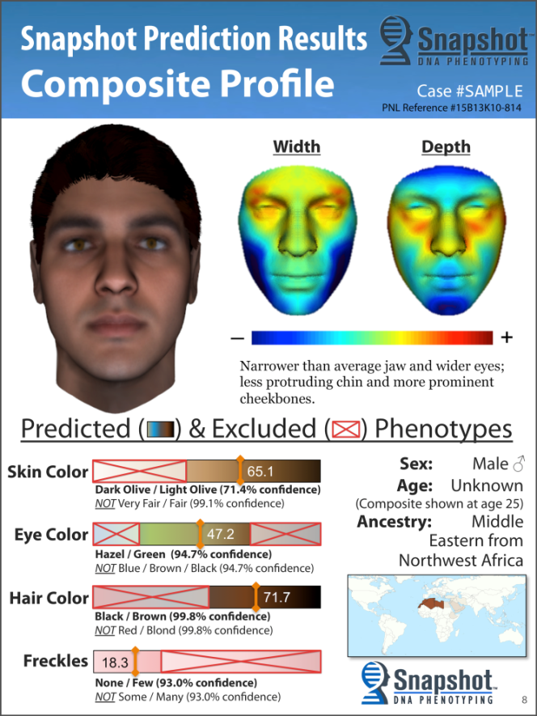
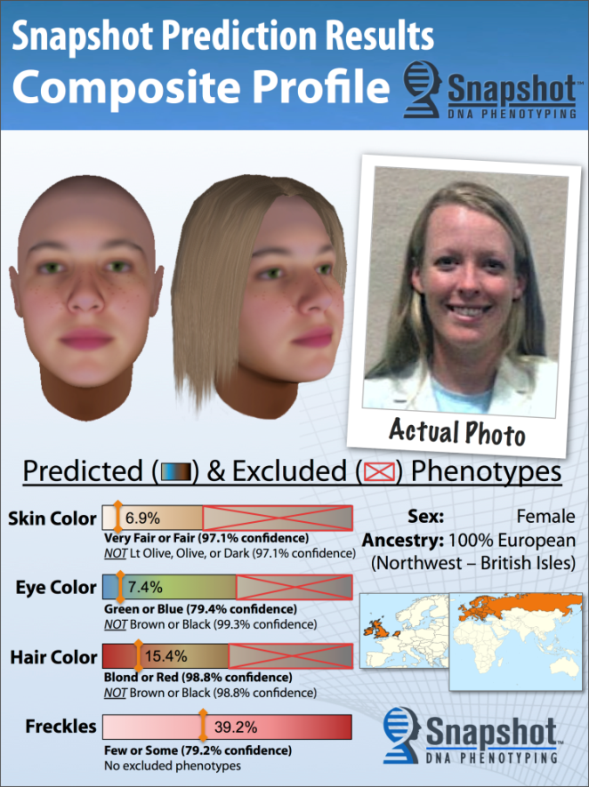
Genomic-Phenotypic Relations
Physical/phenotypic traits are notably determined by genomic data
These dependencies can be used to infer physical traits [8,9]…
… or to match genomic data with physical/phenotypic traits
[8] P. Claes et al., Toward DNA-based facial composites: Preliminary results and validation, Forensic Science International: Genetics, 2014
[9] P. Claes et al., Modeling 3D facial shape from DNA, PLoS Genetics, 2014

Slide 24
Our De-anonymization Attacks
Most common genomic variants (SNPs)
Phenotypic traits (visible and non-visible)
Statistical relationship between genotype and phenotype
Qualitative relations given by a genomic knowledge DB (e.g. SNPedia.com)
unsupervised
Statistics computed over population with known genomic-phenotypic relations
(semi-)supervised
Notes:
SNP = AA -> increased chance to have asthma

Slide 25
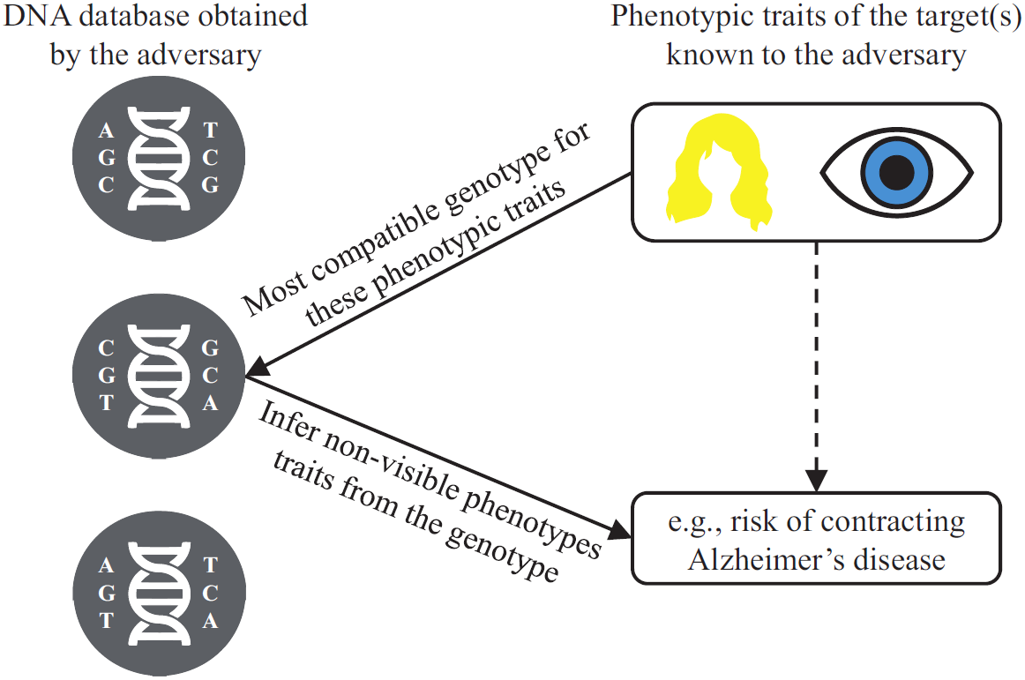
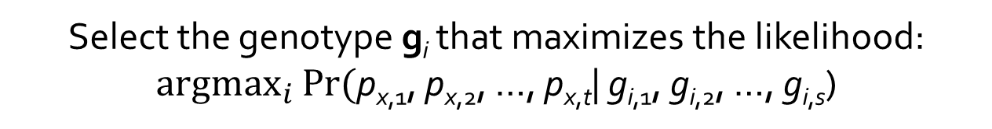
Typical Attack Scenario
n genotypes
1 phenotype
g₁ = (g_{1,1}, g_{1,2}, …, g_{1,s})
p_{x} = (p_{x,1}, p_{x,2}, …, p_{x,t})
g₂ = (g_{2,1}, g_{2,2}, …, g_{2,s})
g_{n} = (g_{n,1}, g_{n,2}, …, g_{n,s})
where g_{i,j} = {0, 1, 2}
Identification attack
Select the genotype g_{i} that maximizes the likelihood:
$\underset{i}{argmax}{Pr(\text{p}\text{x}\text{,1}\text{, }\text{p}\text{x}\text{,2}\text{, …, }\text{p}\text{x}\text{,}\text{t}}$| g_{i,1}, g_{i,2}, …, g_{i,s})

Slide 26
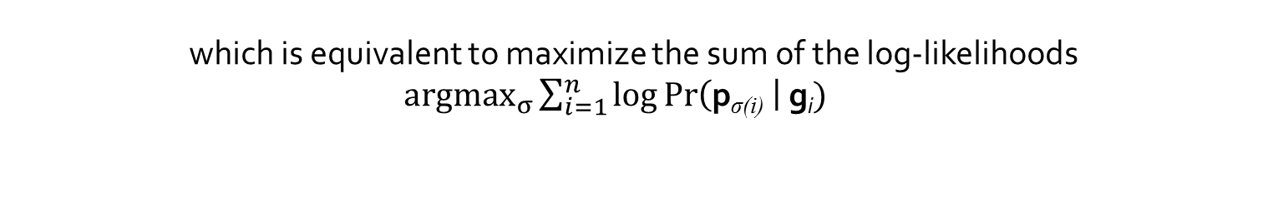



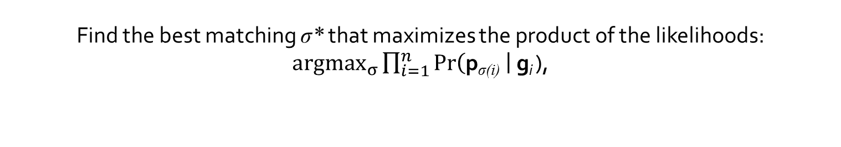
Perfect Matching Attack
$$\text{w}\text{1,1}$$
g₁
p₁
g₂
p₂
. . .
. . .
g_{n}
p_{n}
$$\text{w}\text{n}\text{,}\text{n}$$
Find the best matching σ* that maximizes the product of the likelihoods:
$\underset{σ}{argmax}{\prod_{i=1}^{n}{\operatorname{Pr}\left(\text{p}\text{σ}\text{(}\text{i}\text{)} \right|\text{g}\text{i} }}$),
which is equivalent to maximize the sum of the log-likelihoods
$\underset{σ}{argmax}{\sum_{i=1}^{n}{\log{\operatorname{Pr}\left(\text{p}\text{σ}\text{(}\text{i}\text{)} \right|\text{g}\text{i}}){}}}$
$$\text{w}\text{i}\text{,}\text{σ}\text{(}\text{i}\text{) }$$
Blossom algorithm finding the maximum weight assignment in O(n³)

Slide 27
Data-driven Evaluation
Raw dump of 818 OpenSNP users
Each profile must include genomic and phenotypic data
But many people not sharing their phenotypic traits
By requiring 75% of traits and SNPs present in the data -> 80 individuals
Background knowledge construction
Unsupervised approach: SNPedia.com
Qualitative relations (E.g., «blue eyes more likely»)
Supervised approach: OpenSNP data
SNP-traits associations given by SNPedia
Learning of the conditional probabilities of the traits given the SNPs with the OpenSNP data
Notes:
Some simplifying working assumptions to factor the conditional probability

Slide 28
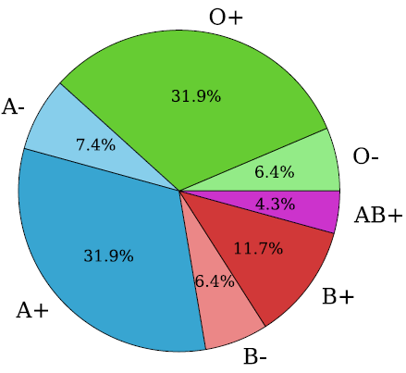
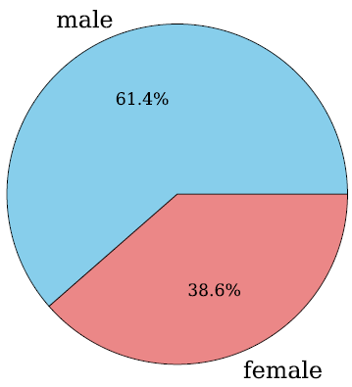
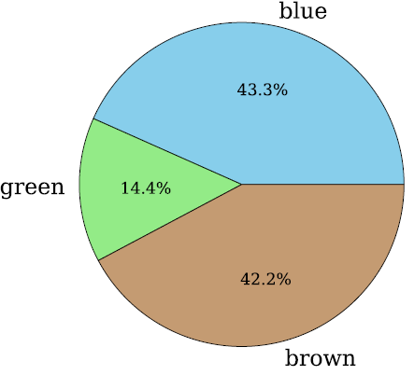
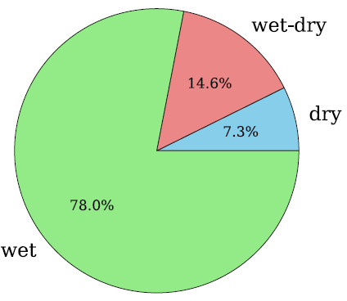
Selected Phenotypic Traits
Unsupervised + supervised
Sex
Hair curliness
Hair color
Supervised only
Skin color
Freckling
Ability to tan
Eye color
Blood type
Earwax type
Asthma
Lactose intolerance
22 associated SNPs + sexual chromosome
17 associated SNPs
Notes:
Proof of concept, in real life, it could already consider more phenotypic traits

Slide 29
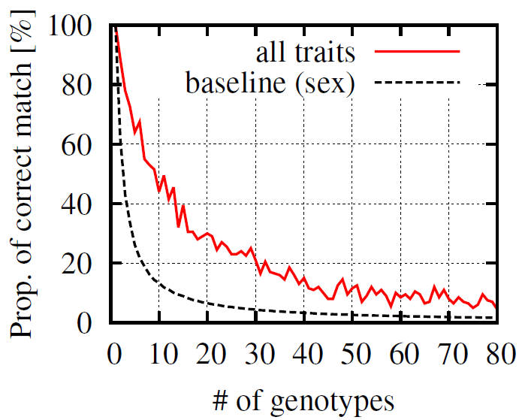
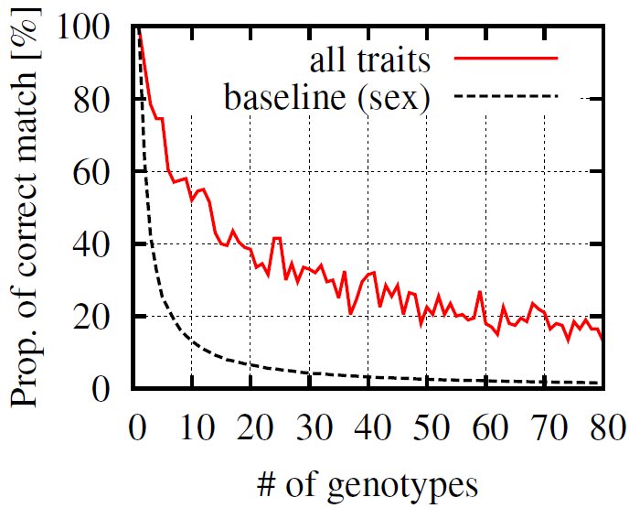
Results – Identification Attack
Attack’s success in the unsupervised scenario
Attack’s success in the supervised scenario

Slide 30
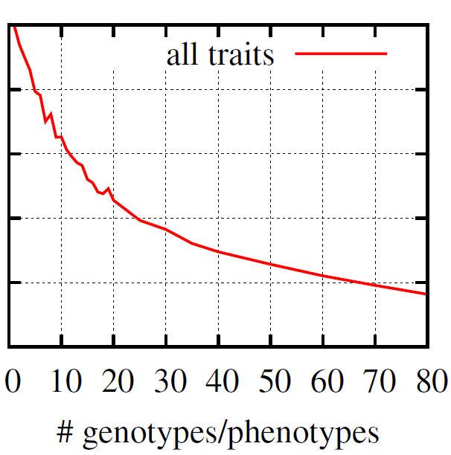
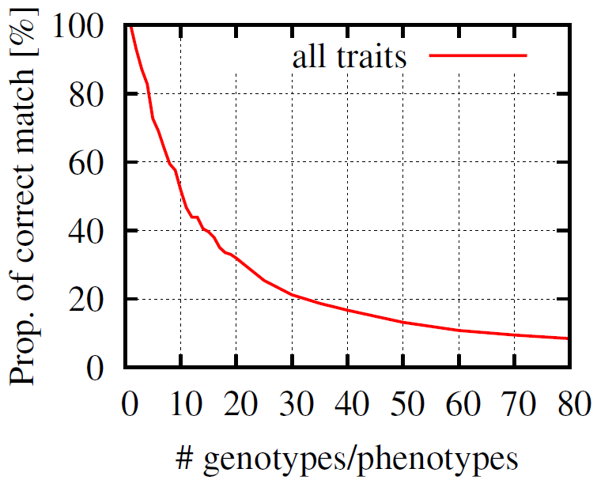
Results – Perfect Matching Attack
Attack’s success in the supervised scenario
Attack’s success in the unsupervised scenario

Slide 31
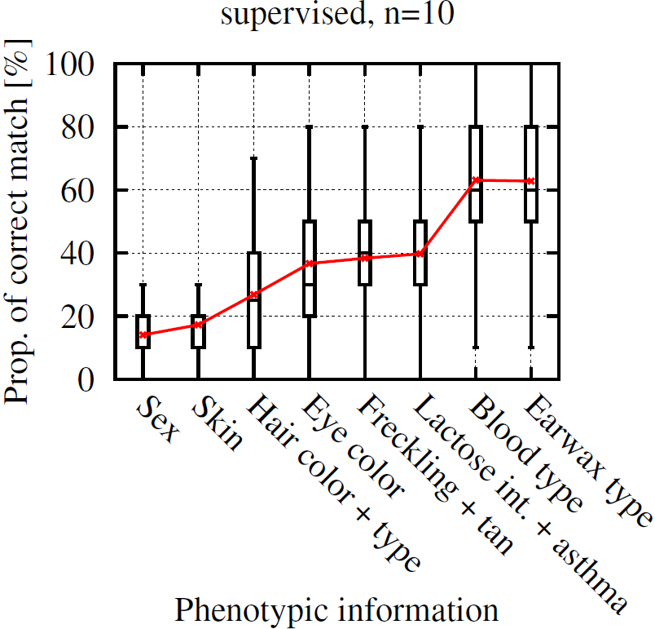
Results – Perfect Matching Attack
Evolution of attack’s success with n=10 individuals w.r.t. the degree of intimacy with the victims
(supervised case)
Notes:
Cumulative information on the x-axis

Slide 32
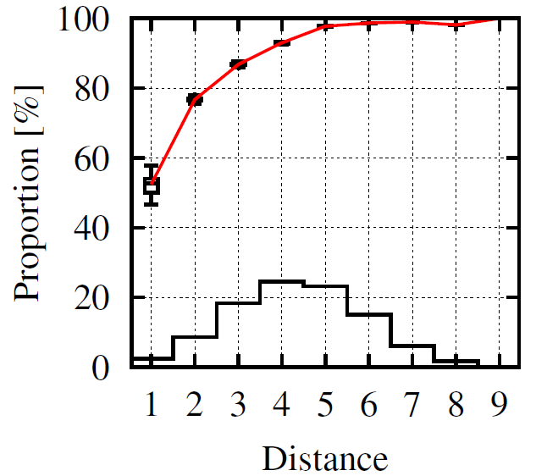
Results – Perfect Matching Attack
Attack’s success with n=2 individuals vs. distinguishability between these two individuals
(unsupervised case)
min(Hamming distance on the phenotypes, Hamming distance on the genotypes)

Slide 33
Summary
Two novel de-anonymization attacks
Making use of most common genomic variants
Mostly relying on existing genomic knowledge
Main results
Identification attack outperforming the baseline by 3 to 8 times
Perfect matching attack more successful than the identification attack: 23% of correct match with 50 individuals
These results will naturally improve (or worsen from a privacy point of view!) with the progress of genomic knowledge
Future work
Use more data => enhanced supervised approach
Implementation of countermeasures (e.g., obfuscation)

Slide 34
Conclusion
The genomic revolution is coming
Millions (if not billions) of people’s DNA will be sequenced in the next decade
Given the very sensitive information its contains, the genome must be protected
First step towards more genomic privacy: fully characterize and formally quantify the risks in order to
Raise general awareness about the risks
Design proper protection mechanisms
Open crucial questions
Economic value and legal ownership of the genomic data

Slide 35
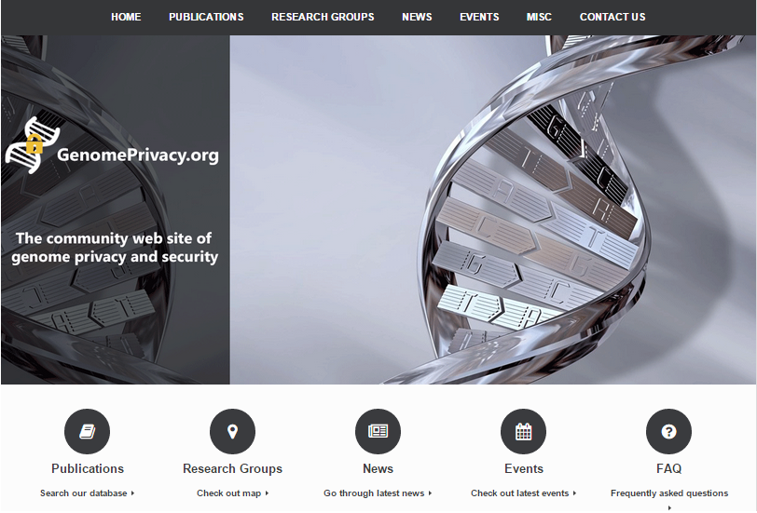
genomeprivacy.org
New community website
Searchable list of publications in genome privacy and security
List of major media news on the topic (from Science, Nature, GenomeWeb, etc.)
Research groups and companies involved
Tutorial and tools
Events (past & future)

